Slide 1
WEATHER SHIFT PREDICTION
TEAM-13
Muskan Havaldar - 01fe19bcs007.
Swathi Pardeshi - 01fe19bcs060.
Srishti Eligar - 01fe19bcs042.
Ankita Mane - 01fe19bcs052.
DEADLINE : 31-10-2021

Slide 2
PROBLEM STATEMENT
The goal is to predict the temperature at a particular latitude/longitude and time, given all available measurements and climate model predictions.

Slide 3
DATA PRE-PROCESSING
Rows containing blank cell are removed.
Columns that do not affect the modeling process majorly are removed.
32% of dataset used(10,00,000 rows x 113 columns)

Slide 4
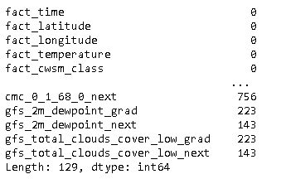
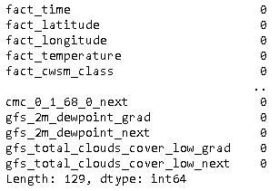
Count of missing values in data set
Before
After

Slide 5
BIAS–VARIANCE tradeoff
BIAS :
The bias error is an error from erroneous assumptions in the learning algorithm.
VARIANCE:
The variance is an error from sensitivity to small fluctuations in the training set.

Slide 6
LEARNING MODELS
LINEAR REGRESSION
ELASTIC NET
XGBoost
CATBOOST

Slide 7
LINEAR REGRESSION MODEL
Multiple linear regression is to model the linear relationship between the explanatory (independent) variables and response (dependent) variables.
The dependent variable is temperature.
The independent variables are all other columns other than meta data and temperature.
RMSE: 2.168

Slide 8
ELASTIC NET MODEL
Elastic net is a popular type of regularized linear regression that combines two popular penalties, specifically the L1 and L2 penalty functions.
RMSE: 2.178

Slide 9
BOOSTING
Boosting is an ensemble learning method that combines a set of weak learners into a strong learner to minimize training errors.

Slide 10
XGBoost
XGBoost is an implementation of gradient boosted decision trees designed for speed and performance.
RMSE: 1.978

Slide 11
CATBOOST REGRESSOR
CatBoost builds upon the theory of decision trees and gradient boosting.
It introduces ordered boosting as a better gradient boosting algorithm
RMSE: 1.9745

Slide 12
Pre-processing (Elastic net model)
Removing rows with missing values
Removing columns
Columns removed: gfs_temperature_(15000….97500)
RMSE: 2.178

Slide 13
Pre-processing 1 (XGBoost)
Removing rows with missing values
Removing columns
Columns removed: gfs_temperature_(15000….97500)
Parameters:
colsample_bytree=0.4, gamma=0, learning_rate=0.3, max_depth=6, min_child_weight=1, n_estimators=100, reg_alpha=0.75, reg_lambda=0.45, subsample=0.6, seed=42.
RMSE: 1.978

Slide 14
Pre-processing 2 (XGBoost)
Removed metadata column
Filled missing cells with 0
RMSE: 4.49

Slide 15
Pre-processing (CATBOOST REGRESSOR)
Removed metadata column
Filled missing cells with 0
Parameters:
Iteration=2000
Learning rate = 0.04
RMSE: 1.9745

Slide 16
RESULTS
MODEL | RMSE value
LINEAR REGRESSION | 2.168
ELASTIC NET | 2.178
XGBoost | 1.978
CatBoost | 1.9745

Slide 17
THANK YOU

